Slide 1
Administrative Standard Work

Slide 2

Other Modules In This Series:
5S
Standard Work
Total Productive Maintenance (TPM)
Administrative Lean
Cell Design/ Production Preparation Process (3P)
Kaizen
Kanban
Problem Solving
Poka Yoke Quality Systems
Transaction Process Improvement (TPI)
Cause & Effect Diagram with the Additions of Cards (CEDAC)
Single Minute Exchange of Dies (SMED)
Value Stream Mapping (VSMi®)
Visual Management
Managing Daily Process Excellence
For More Information Please Contact:
Mark DeLuzio, President and CEO
+1.860.234.0915
mark.deluzio@leanhorizons.com
Strategically Creating Value Through the Elimination of Waste

Slide 3
This document contains confidential
and proprietary information owned
by Lean Horizons Consulting, LLC.
Any disclosure, use, copying or
distribution of this information without the express written consent of Lean Horizons Consulting is strictly prohibited.

Slide 4
Ground Rules for Event
Safety first (use personal protective equipment)
Active participation by all
Start and end on time
All electronic gadgets (phones, pagers, etc) turned to “off” or “silent”
Computers to be used only when instructed
Keep an open mind to change
Don’t let “perfect” get in the way of “better”
Notes:
DO: Perform Group Introductions. Pick an ice-breaker or exercise to warm the team up to the event. (Icebreaker Example: Everyone uses their name tent and writes a “Personal License Plate” in which they have 2 minutes to creatively use a total of 7 letters or numbers to tell us something about themselves. Examples “LV2SAIL” OR “DADOV5”
DO: Review Event Ground Rules.
ASK: “Does anyone have any rules they would like to see added?”
ASK: “Does everyone agree to these?”

Slide 5
Goal of Standard Work Module
To define Standard Work and apply the Standard Work process and tools to achieve a target goal for your business.
Takt
Time vs.
Process Time
Work
Sequence
Standard
Work In
Process
(WIP)
Standard
Work
Documentation
Notes:
DO: Introduce the notion of Standard Work and the goal of this event.

Slide 6
Cycle of Improvement
Standardize/
Adherence
Implement
Solutions
Expose and
Quantify Problems
Root Cause
Notes:
SAY: “Kaizen is a methodology used for the implementation of improvements. A key benefit is that the structure of the kaizen event is primarily encompassed in a 5 day period (including implementation). This is the opposite of project oriented improvements which tend to take weeks and months.
SAY: “The key steps are to identify waste and eliminate waste.”
SAY: “Kaizen is a continuous improvement mindset. Everything that we do today can be improved. Kaizen has no end.”

Slide 7
Standard Work: There can be no improvement without a standard
A tool that defines the interaction of people and their environment when processing a product or service
It details the work of the associate and work sequence used to produce any product or service
It provides a routine for consistency of an operation
It details best processes we currently know and understand
Provides a basis for improvement by defining the normal and highlighting the abnormal
Notes:
DO: Introduce the notion of Standard Work and the goal of this event.
SAY: “Standard Work is a foundational element of the Toyota Production System.”

Slide 8
Standard Work Characteristics
Is a documented process.
Process must be repetitive to apply Standard Work concepts.
Separate focus on the Associate.
Separate focus on the equipment (computer, printer, fax) and systems.
Combined focus on the interaction of Associate and equipment.
Is different than a traditional timing of task study:
  Takes customer demand and expectation into consideration
  Expects that the Associate will perform multiple, repetitive tasks within a work sequence
  Does not promote the building of unnecessary queues
Notes:
SAY: “We just discussed the straight forward definition of standard work. There are subtleties that distinguish standard work. Note, the separate focus of the Front Line Associate and of the equipment and systems. After the separate focus, there is a combined focus of the interaction between the Front Line Associate and the equipment and systems. Standard work is not the same as traditional timing of task study. The differences include (TAKT time–customer demand, expects the Front Line Associate to perform multiple repetitive operations within a work sequence and does not promote the building of unnecessary queues).”

Slide 9
Standard Work Improves Productivity
Output
Input
P =
Standard Work impacts both sides of the equation
To improve productivity:
Output must go ___ at same input level
Input must go ____ at same output level
Notes:
SAY: “Productivity is equal to output over input. Improving productivity is an outcome of standard work. Standard work affects both the numerator and denominator.”
There are only two ways to improve productivity.
Output (e.g. – products/services) goes up with the same level of input (e.g. – man hours/number of associates required)
Inputs (e.g. – man hours/number of associates) goes down with the same demand level (e.g. – products/services)

Slide 10
What an Associate Must Know
How do you do this work?
How do you know you are doing this work correctly?
How do you know the outcome is free of defects?
What do you do if there is a problem?
Rule #1: Work shall be highly specified as to
Content, Sequence, Timing and Outcome
Notes:
SAY: “When thinking about the world standard for a continuous improvement culture you have to look to Toyota. They have been pursuing a lean strategy for the past 60 years and it has become a cornerstone for their success. Standard work is one of the foundations for their lean strategy and in order for this to work there are several things that every Toyota employee knows about their job.
Toyota, like any business, has many processes that adhere to their philosophy. Most make a mistake in thinking that their methods only apply to manufacturing since most readily associate Toyota as synonymous with cars. Toyota, like your business, has many more processes that involve movement of papers, decision making, trouble shooting, daily management, problem solving, etc. that they apply these principals to. If they only used this method in their car manufacturing part of the business they simply would not be the world leader they are today. These processes must be applied anywhere there are people and processes used to conduct an output desired by internal or external needs or customers.
They are:
How do you do this work?
This means that the work sequence and instructions are documented, applicable, and clearly understood.
How do you know that you are doing this work correctly?
This is accomplished through a combination of training and qualification for the employee as well as visual management systems and feedback loops that let the employee know if they deviate from the process.
How do you know that the outcome is free of defects?
Again this relates to the visual management systems and feedback loops which allow the employee to identify any abnormalities but in addition there is a fundamental belief that a good process can’t yield a bad result. Because of this belief Toyota invests an incredible amount of effort in developing and constantly improving their processes. If there is an abnormality or defect the first thing that they do is check to insure that the employee followed the process. If the process was followed and there was a defect they will then attack the process to determine what failed and allowed the abnormality. They will then install a root cause fix so that the problem cannot arise again. This sequence ties back to the cycle of improvement and the Deming cycle.
What do you do if you have a problem?
The lines of escalation are clearly understood and the process is straight forward.
Stop work to prevent production of further defects. It doesn’t matter if it is a car or a financial transaction work is stopped to prevent passing a defect on to the next process.
The correct, pre-identified, resource is notified. This may be a team leader, supervisor, manager, technician, or the pope; who ever it is has been identified in advance and when they are notified this becomes their #1 priority.
SAY: The ultimate take away for this slide is that for all tasks, the work shall be highly specified as to content, sequence, timing and outcome. I know that if I do these things in this way at this rate I will get this output, it is as simple as that.”

Slide 11
Elements of Standard Work
Takt Time
  The rate of customer demand
Work Sequence
  The order in which the work tasks are always performed
Standard Work in Process
  The minimum number of transactions in the process, at anytime, required for the process to function properly
Notes:
SAY: “The three elements of Standard Work are Takt Time, Work Sequence, and Standard WIP. We will go into each of these in more detail.”

Slide 12
Value Added vs. Non-Value Added
Non-Value Adding Process
Value Adding Process
Those process steps that take time, resources, or space, but do not add value to the product or service
A process step that transforms or shapes a product or service which is eventually sold to a customer
Who is the customer?
Notes:
DO: Have the discussion around knowing who your various customers may be for a process. What might not be considered value-adding to one customer, may be considered value-adding to another.
Define or stipulate that there are internal and external customers in any process. They could be referred to as the “little C” and “big C”. We all have customers that we must satisfy and it is possible that none of them are the actual end customer that buys the products or services.

Slide 13
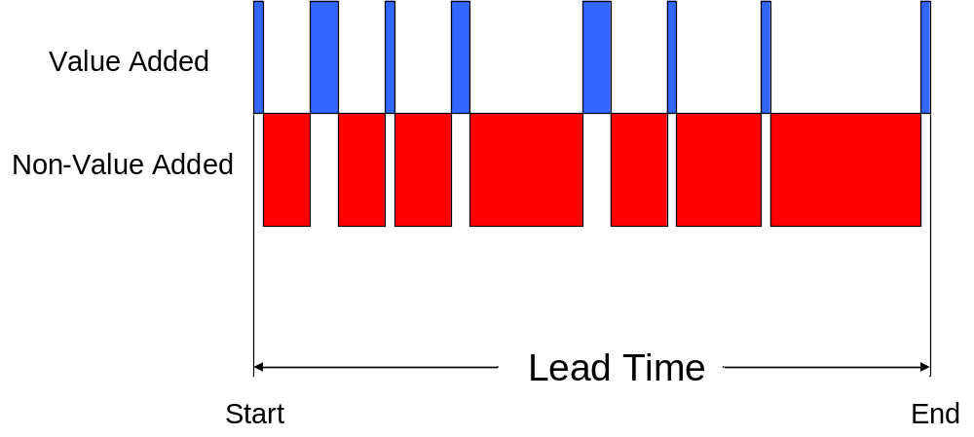
Value Added vs. Non-Value Added
XYZ Value Stream
Non-value added activity increases
Lead times
Adds cost
Creates opportunities for errors
Increases queues and inboxes
Inhibits Flow
Notes:
SAY: “In the previous slide, the definitions of Value Added (VA) and Non-Value Added (NVA) were introduced. This slide continues to help define the difference between VA and NVA, and helps provide a visual representation.”
SAY: “It is helpful to use a process as an example. One easy example is a paying an invoice, that goes through several operations that are VA; cutting of the check, signing of the check, etc. Mention the 95/5 split, but it’s better to use an example that the audience experiences. Get the audience to tell you how long the VA steps take for one of their processes; 10 seconds to cut the check, 1 day in the inbox, 10 seconds to have the check signed, 1 day to mail, etc. Then ask for the estimated lead time. Next, do the math to give the % split. Administrative tasks are normally much less than 5% VA.”
History: The in the 90’s, Boston Consulting Group a global consulting company, conducted a study of several businesses and industries to determine the amount of activity conducted in the process of delivering products or services to the customer. What they found was that 95% of the activity in these business done on a daily or recurring basis had no value to the customer buying the products or services. What remained was only 5% which actually applied to what the customer wanted.
It should be mentioned that this study and the 95/5 rule does not mean that 95% of the actions we do have no value meaning that we have no value. Simply put it means that much of what we do does not convert into something a customer is willing to pay for. An example of this would be what a customer pays for when they take an airline flight. When purchasing a ticket as a customer you simply want to get from one destination to another. You do not desire to pay for things that do not relate to you direct flight. Have the class detail some of the things that happen to complete a flight and discuss whether they add value.

Slide 14
Value Added vs. Non-Value Added
Lean tools help identify and eliminate waste from our processes, leading to:
Reduced costs and lead time
Faster response
Improved quality
Reduced queues
Better predictability
$
$
$
$
$
$
$
$
$
$
Waste
Waste
Lead Time
New
Lead Time
Notes:
SAY: “One point to make is that we are focusing on eliminating waste, not trying to improve value added steps.”
SAY: “As waste is eliminated or reduced, lead time is reduced, cost is reduced, quality is improved by reducing the number of opportunities, and queues reduced. Predictability is improved, which reduces variation.”

Slide 15
Exercise: Standard Work Charter Review
Objective
Review the Standard Work Charter for the event against charter criteria
Instructions
Time to Complete
As a team review the event charter and answer the following questions:
What is the business need for this event?
Who is the owner?
What are the goals for this event?
15-30 minutes
Deliverable
Make any modifications
to charter as necessary.

Slide 16
TAKT Time vs. Process Time
Takt Time vs.
Process Time
Work
Sequence
Standard WIP
Documentation
Objectives:
Define “takt time”
Calculate takt time
Differentiate process time from takt time
Identify types of process time
Calculate number of Associates
Calculate process time
Notes:
DO: Review section objectives on slide.

Slide 17
TAKT Time
TAKT Time vs. Process Time
1
2
3
Definition
Calculation
Origin
How often you should perform a task, based on the rate to meet customer requirements
Available Working Time (per shift)
Customer Demand (in units)
Expressed in seconds
German
Translated means a precision of musical meter
Takt time measures the “beat” of customer demand
Notes:
SAY: “TAKT time is defined as the rate at which you should produce one transaction or unit of work based on the rate of sales to meet customer demand. TAKT time should be expressed in seconds and is calculated by (read the equation).”
Every process regardless of where it happens has a takt time. You must define who your customer is and then determine what demand. This does not just apply to manufacturing.

Slide 18
TAKT Time Example
TAKT Time vs. Process Time
Takt Time Calculation
Takt Time Definition
Available Working Time
_____________________________
Customer Demand
How often does “something” need to exit the value stream in order to support the overall demand for the product of service.
450 minutes/day
_____________________________ = .5 min/app
900 applications/day
Note on Takt Time
Takt Time can be very beneficial in determining the approximate level of staffing required to support demand.
Notes:
REFERENCE FOR MORE ON ORIGINS OF TAKT TIME:
This term is an interesting example of a word moving from region to region until it is now becoming standard in German, Japanese, and English. The word itself, meaning a precision interval of time, as in musical meter, was first introduced in German industry as it embraced mass production in the 1930s. German aircraft firms moved aircraft fuselages ahead to the next workstation at steady intervals determined by the Takt time. Mitsubishi imported the term in its German form for its own aircraft production efforts in Japan and the term was later taken up by Toyota. It has only crept into English in the last decade as lean thinking has spread. For the historical details see Kazou Wada, "The Emergence of the 'Flow Production' Method in Japan," in Haruhito Shiomi and Kazuo Wada, Fordism Transformed: The Development of Production Methods in the Automobile Industry (Oxford: Oxford University Press, 1995.
Later research led to the information that the specific German production line in question was the one for the Junker airplane.
Source:
James P. Womack
and Daniel T. Jones,
Lean Thinking, 1996
SAY: “TAKT time is defined as the rate at which you should produce one part based on the rate of sales to meet customer demand. TAKT time should be expressed in seconds and is calculated by (read the equation).”

Slide 19
Calculating TAKT Time Example
TAKT Time vs. Process Time
Takt Time Calculation
8
480
____ Hrs = _________ Minutes (Based on standard work shift)
- ________ Minutes (Break Time)
- ________ Minutes (Wash Time)
- ________ Minutes (Clean-up)
Total ______ Available Minutes per Shift
Available Working Time
_____________________________
Customer Demand
30
Customer Demand = 190 apps
450
450
Example
________ Minutes Available x 60 = ________ Seconds per shift
________ Seconds Divided by _____ pcs/shift = _______ Seconds
TAKT Time = __________ Seconds
per Piece
190
Notes:
DO: Review the definition for TAKT time here and the exact calculation. Here is a simple template you can use to properly categorize the elements of TAKT time. Your actual calculation may be a little more difficult, but will follow the same fundamentals.
DO: Based on the amount provided on the slide, 190 units for daily demand, the TAKT Time equation would be:
450 min avail x 60 sec = 27,000 sec per shift
27,000 sec/190 units/shift = 143 seconds
TAKT Time = 143 seconds per piece (meaning the customer needs us to make one unit every 143 seconds)

Slide 20
Three Types of Process Time
TAKT Time vs. Process Time
1
2
3
Associate Process Time
Equipment Process Time
Total Processing Time
The amount of time it takes an Associate to complete one full process in his/her assigned work sequence
Defined as the amount of time it takes a piece of equipment to completely finish one full process (start/stop time)
The equipment process time PLUS the manual time it takes an Associate to complete one process and amortized time to setup next job
Process Time is NOT to be confused with Takt Time
Notes:
DO: Review definitions on the slide and then speak specifically to each type on the following slides.
SAY: Equipment could be a fax machine, copy machine, printer, etc.

Slide 21



Associate Process Time Defined
TAKT Time vs. Process Time
Associate Process Time
The amount of time it takes an Associate to complete one full process in his/her assigned work sequence
Example: It takes the Associate 10 minutes to perform operation 1-2-3 and return back to 1, ready to begin another process
3
2
1
Notes:
SAY: “The Associate process time is the time it takes an Associate to complete one full process in his/her assigned work sequence.”

Slide 22

Equipment Process Time Defined
TAKT Time vs. Process Time
Traditional Batch Processing
Defined as the amount of time it takes a piece of equipment to completely finish one full process (start/stop time)
Has nothing to do with the actual hands on work of the Associate
GO
1. Hit Process Start
STOP
3. Equipment Finished
Notes:
SAY: “In calculating Equipment process time remember that this has nothing to do with the Associate. It is the time it takes a piece of equipment to completely finish one full process.”
NOTE: People commonly confuse the time required for a report to run in the background with operator process time (processing time). They need to know the difference.
Example: think of a washing machine for your clothes. The machine does the work and rarely do we stand there and assist or watch it. The time the machine spends washing the clothes is the equipment process time and is separate from the time spent by the person who loads/unloads the machine.

Slide 23
Total Process Time Defined
TAKT Time vs. Process Time
The equipment process time PLUS the manual time it takes an Associate to enter data or load/start the equipment
Notes:
SAY: “The third type of process time to define is Processing process time. The equipment process time plus the manual time it takes the Associate to unload, load and process start the equipment”

Slide 24
Exercise: Process Time
TAKT Time vs. Process Time
Objective
Calculate types of process time.
Instructions
Time to Complete
Use the information on the following slide to
calculate the following:
Total Associate Process Time
Processing Time for equipment time
10 minutes
Deliverable
Discuss answers as a class
Notes:
ANSWERS: (post on a chart paper or whiteboard in the room)
Total Associate Process Time: Total Associate Process time is the sum of the time it takes to process the print request on the computer and send to plotter, to check the quality of the print, and the time to process the release form
Process request on computer: 6 minutes
Check Quality of print 3 minutes
Process drawing release : 6 minutes
Total 15 minutes
Processing Time for plotter: The processing time for the plotter is the plotting time itself. The downloading of the next job is done during the plotter run time.
So, 10 minutes.

Slide 25
Exercise: Process Time
TAKT Time vs. Process Time
Associate process time for processing the drawing print request via computer is 6 minutes, retrieving drawing and sending to plotter
On average, plotter takes 10 minutes to plot print
Associate checks if print is correct number and the quality of the print, which takes 3 minutes
Associate fills out release forms and routes print to the proper person via mail drop, which takes 6 minutes.
On average, associate must refill or change paper type on the plotter 5 times per day, requiring 5 minutes per setup
Associate then repeats process
Notes:
NOTE: The information on this slide corresponds to the exercise on the previous slide.

Slide 26
Exercise: Takt Time
TAKT Time vs. Process Time
Objective
Use takt time and process time to make decisions.
Instructions
Time to Complete
In pairs, read and answer the following.
Consider the following data:
Your bottleneck plotter in Engineering has
a process time of 10 minutes.
The takt time for the print process is 8 minutes (one shift operation)
What are your options? What would you do?
10 minutes
Deliverable
Discuss answers as a class
Notes:
DO: First have the class work in pairs to answer the question. Call on people for the answers. Discuss.
ANSWERS: Some options: Work overtime, kaizen the process to understand the process time of the bottleneck equipment, work additional shifts
NOTE: The term “bottleneck” refers to the process/machine where processing time is greater than TAKT time. When flow is in place, each process must be able to product to TAKT time or less in order to meet customer demand.

Slide 27
Work Sequence
Takt Time vs.
Process Time
Work
Sequence
Standard WIP
Documentation
Objectives:
Define “work sequence”
Differentiate Associate Flow vs. Work Flow
Determine work sequence
Calculating number of Associates
Notes:
DO: Review objectives of the section.
NOTE: Work flow refers to the unit of information or transaction that is being processed (ie: invoice, receipt, application, spec sheet, etc).

Slide 28

Work Sequence Defined
Work Sequence
The specific order in which an associate performs manual steps of a process for one transaction or unit of work
11
10
9
8
7
6
1
2
3
4
5
Notes:
SAY: “Work sequence is defined as the specific order in which an Associate performs the manual steps of a process for one transaction or unit of work.”

Slide 29
Determining Total Number of Associates Needed
Work Sequence
Points Descriptions
1
Calculation for
Total # of Associates
Sum of the Total Associate Process Times
Takt Time
2
Example
Total Process Time = 270 seconds
Takt Time = 77 seconds
Total Number of Associates Needed = 3.5 Associates
3
Question
How do you staff for 3.5 Associates?
Notes:
SAY: “To determine the number of associates needed, sum the total Associate Process times and divide by the TAKT time. This result is the number of associates required to produce at TAKT time.”

Slide 30
Partial Associate—Guidelines
Work Sequence
Remainder in # of Associates | Guideline
<.3 | Do not add another Associate. Look for waste and kaizen opportunities to eliminate this work.
.3 - .5 | Do not add another Associate yet. Run area for two weeks and evaluate if enough waste exists to reduce the Associate process time.
>.5 | Add another Associate if necessary and continue to reduce waste and Associate process time which will eventually eliminate the need for this associate.
Notes:
SAY: “In most cases, when the number of Associates needed is calculated, the result will not be a whole number. The recommended staffing based on the calculation is: (read chart). In the early stages this guideline can be very helpful. Many times people, in their zest to make change, will remove any and all fractional heads. Recommendation is to not fall into that trap. This will help ensure a high probability of success.”

Slide 31
Exercise: Putting it all together
Work Sequence
Objective
Calculate the takt time, number of Associates, and determine the best
work sequence for each Associate.
Instructions
Time to Complete
In small groups, calculate takt time, number of
Associates, and determine the work sequence for each of the examples on the following three slides.
15 minutes
Deliverable
For each example, determine takt time, number of Associates, and work sequence
Notes:
SAY: “We will now do some exercises to demonstrate the interaction between TAKT time, number of Associates and work sequence for each Associate. Remember to pick up raw material (RM) and place the finished good (FG) into the finished good container.”

Slide 32
Exercise
Work Sequence
Daily Demand: 18 invoices
Available Time: 450 minutes
Takt Time: _________________
Number of Associates: _______
Draw the work sequence for each associate:
Mail
Check
5 min
Process Check
7.5 min
4
3
1
2
Receive
3.5 min.
Data Entry, Verification
9 min
Notes:
ANSWERS:
450 x 60 = 27,000 sec available time
Takt Time = 27,000/18 invoices = 1,500 seconds
Associate 1: Receives 3.5min (210sec)
Data Entry, Verification 9 min (540sec)
Process Check 7.5 min (450sec)
Mail check 5 min (300sec)
Total: 25 min process time for associate #1 (1,500sec)
Number of Associates = (Sum of process times)/(takt time) = (210 + 540 +450+ 300)/1500
# of Associates =1,500sec/1,500sec = 1 associate

Slide 33
Exercise
Work Sequence
Daily Demand: 36 invoices
Available Time: 450 minutes
Takt Time: _________________
Number of Associates: _______
Draw the work sequence for each associate:
Mail
Check
5 min
Process Check
7.5 min
4
3
1
2
Receive
3.5 min.
Data Entry, Verification
9 min
Notes:
ANSWERS:
Takt Time = 750 seconds (12.5 minutes)
Number of Associates = (Sum of process times)/(takt time) = (210 +540+ 450 + 300)/750 seconds
Number of Associates = 1500sec/750sec = 2 operator
Associate 1: Receives 3.5min (210sec)
Data Entry, Verification 9 min (540sec)
Total: 12.5 min process time (750sec)
Associate 2: Process Check 7.5 min (450sec)
Mail check 5 min (300sec)
Total: 12.5 min process time (750sec)

Slide 34
Standard Work In Process (WIP)
Takt Time vs.
Process Time
Work
Sequence
Standard WIP
Documentation
Objectives:
Define Standard Work in Process (WIP)
Calculate Standard WIP
Notes:
DO: Review objectives of the section.

Slide 35
Standard WIP
Standard WIP
Points Descriptions
Standard Work
In Process
(WIP)
Minimum amount of work in process that will allow the associate to flow the work efficiently
Any time the process time of a process or the lead time of an external process is longer than takt time work is needed in the form of Standard WIP
1
2
Standard WIP
Calculation
Process Time
Takt Time
Notes:
SAY: “A common term used in standard work is Standard Work-in-Process. The common abbreviations are WIP or SWIP. Standard WIP is defined as the amount of jobs/work required on the line that will allow the Associate to flow efficiently.”

Slide 36
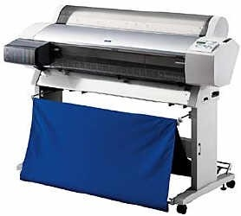


Standard WIP
Standard WIP
2. Plot Drawing
3. Mail Routing
1. Retrieve Print
To
Customer
Dwg
Request
Standard WIP = 3
Standard Work in Process
Notes:
SAY: “For this layout the Standard WIP is 3 pieces.
As and example, Plotting machine process time is 10 minutes. During the process time of the plotter, the associate will be Mailing out the previous print request(5 min) and Retrieving the next print request(5 min). Thus, a need for 1 WIP at both Retrieve Print and Mail Routing, while 1 WIP is being processed in the Plotter. Total of 3.
Later we will explain the process for determining how many and where to place the Standard WIP. During the long plotting process, Mail routing is prepared and next print request is processed.”

Slide 37
Standard Work Documentation
Takt Time vs.
Process Time
Work
Sequence
Standard WIP
Documentation
Objectives:
Identify components and use of the Standard Work Documentation:
  Time Observation Form
  Process Capacity Sheet
  Standard Work Combination Sheet
  Standard Work Sheet
  Associate Loading Chart
Define purpose of Standard Work Playbook
Identify components of the Kaizen Results Form
Notes:
DO: Review objectives of the section.
SAY: “ Process Capacity Sheet is rarely applied in administrative standard work. It gauges if the current equipment has the appropriate throughput capacity.”

Slide 38
Standard Work Documentation Forms are Management Tools
Standard Work Documentation
Time Observation Form
Process Capacity Form
  Rarely used in an administrative setting
Standard Work Combination Sheet
Standard Work Sheet
Associate Loading Chart
Notes:
SAY: “There are five forms used for documenting standard work: Time Observation Form, Process Capacity Form, Standard Work Combination Sheet, Standard Work Sheet and the Associate Loading Chart. We will now review the contents of each of these forms.”
Without the completed Standard Work documentation there is no Standard Work.

Slide 39
Time Observation Form
Standard Work Documentation
Used to document process time of an Associate and his/her complete work sequence
7-10 observations typically taken
Lowest observable process used
Key input to Standard Work Combination Sheet
Notes:
SAY: “The first form is the Time Observation Form. It is used to document the process time of the operator. The expectation is you can monitor the operator for 7–10 processs of the operator executing a task. You will record the lowest observable task time as the observed time to complete a task. This assumes you do find abnormalities during the observation. An abnormality may be something like the operator misses a step and is then able to have an observable time well below the other observable times. The Time Observation form is a key input to the Standard Work Combination Sheet.”
NOTE: “The reason we take the lowest observable time and not the lowest “repeatable task time” is because Standard Work is a tool used for improvement. If the operators were observed being able to do a task at a certain time (barring any abnormalities that would discount the observation), then that time should be used as the benchmark to strive towards. Standard Work is a tool used for improvement, not documentation.”

Slide 40
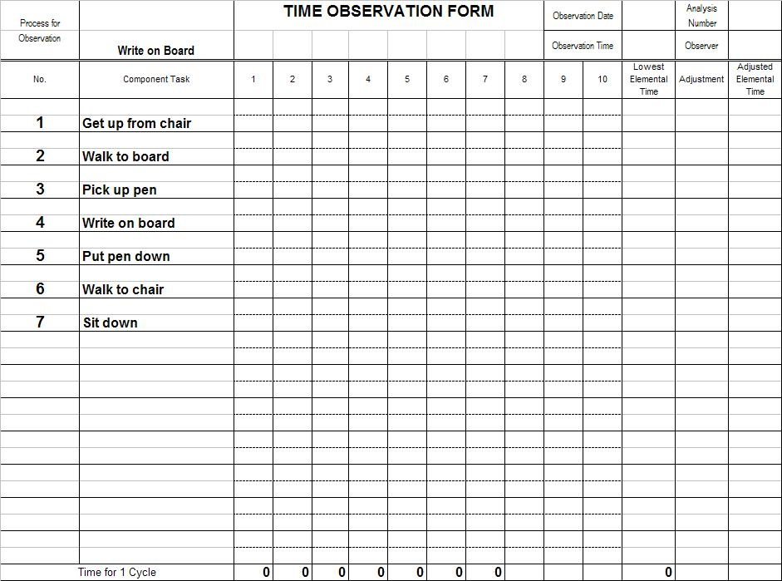
Time Observation Form
Standard Work Documentation
Step 1: List the process sequence.
Notes:
SAY: “The first step in completing the time observation form is to record the process step in sequence.”

Slide 41
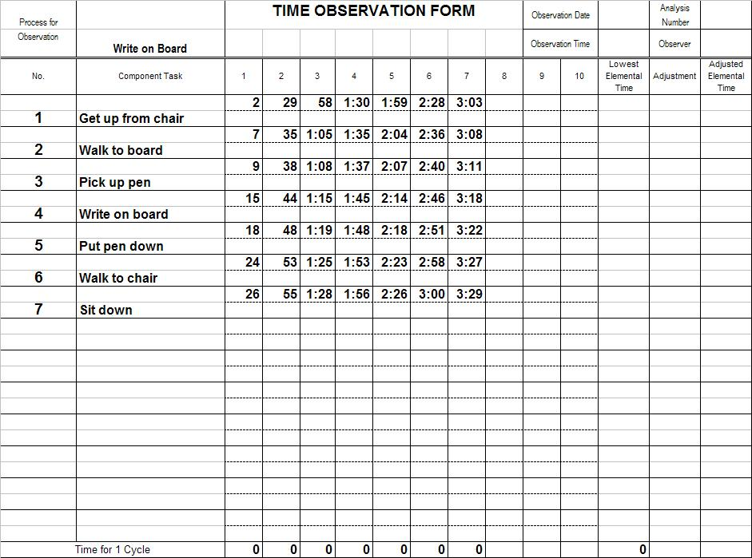
Time Observation Form
Standard Work Documentation
Step 2: Record time with a running stopwatch
Notes:
SAY: “Then, using a running stopwatch, record the time when each task is completed. If you miss one time, keep going.”

Slide 42
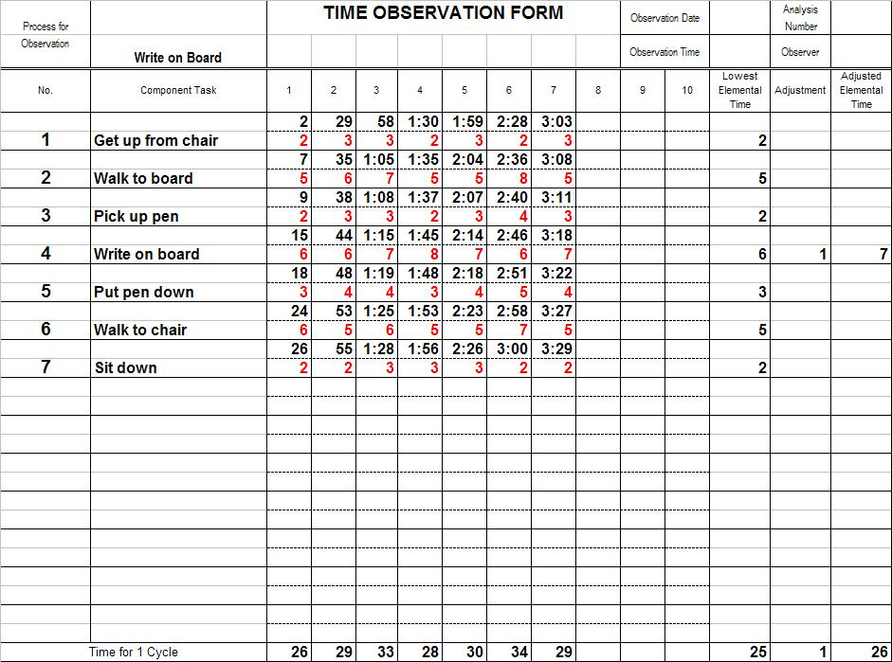
Time Observation Form
Standard Work Documentation
Step 3: Do calculations.
Notes:
SAY: “Now, place the lowest observable time to complete each process step into the column “Lowest Elemental Time.” Then add those times in that “Lowest Elemental Time” column and post the sum in the bottom row of that column (in our case 25 secs). Look at the bottom row labeled “Time for 1 process”, find the shortest process and post that number in bottom row of the column labeled “Adjusted elemental time”. Compare the sum of the lowest elemental times to the lowest “Time for 1 process”. If the sum in the “Lowest Elemental Time” column is less than the lowest “Time for 1 process”, post the difference in the last row of the column labeled “Adjustment”. Also, post that number in the “Adjustment” column next to the larger* elemental time(s). Then post the total of each Lowest Elemental Time and its Adjustment in the “Adjusted Elemental Time” column and assure that the actual sum of Adjusted Elemental Times matches the number we posted in the last row of the “Adjusted Elemental Time” column.
* We do it to the larger since the % effect is the smallest there.”

Slide 43
Time Observation Tips
Standard Work Documentation
One form per Associate
Let Associates do the time observation
If you miss a time, keep going – don’t stop
Make sure your observation points are logical
Note any areas for kaizen as you are taking times
Note abnormalities
Notes:
SAY: “The Time Observation sheet needs to be completed for each Associate. Don’t hesitate to allow the Associate to observe other Associates doing the task. Though it is noble for you to try to perform the tasks, do so at a different time; unless you maintain current certification for the task, do not use your time in the time observations. Keep the stopwatch running so if you miss a time you can keep going. Have logical observation points for each process step. It is okay to note ideas for kaizen on your sheet, they will be discussed later. Note abnormalities spotted during the observation.”

Slide 44
Standard Work Combination Sheet
Standard Work Documentation
Graphically “combines” the interaction of the Associate and equipment
Provides for a repeatable standard to follow
Compares relative process times with TAKT Times
Used to identify areas for improvement
Notes:
SAY: “The Standard Work Combination Sheet is the graphical representation of the interaction between the Associate and the equipment. The Standard Work Combination Sheet provides the repeatable standard for the Associates to follow. There is a comparison relative between the process times and the TAKT time, and it provides an opportunity to identify areas for improvement.”

Slide 45
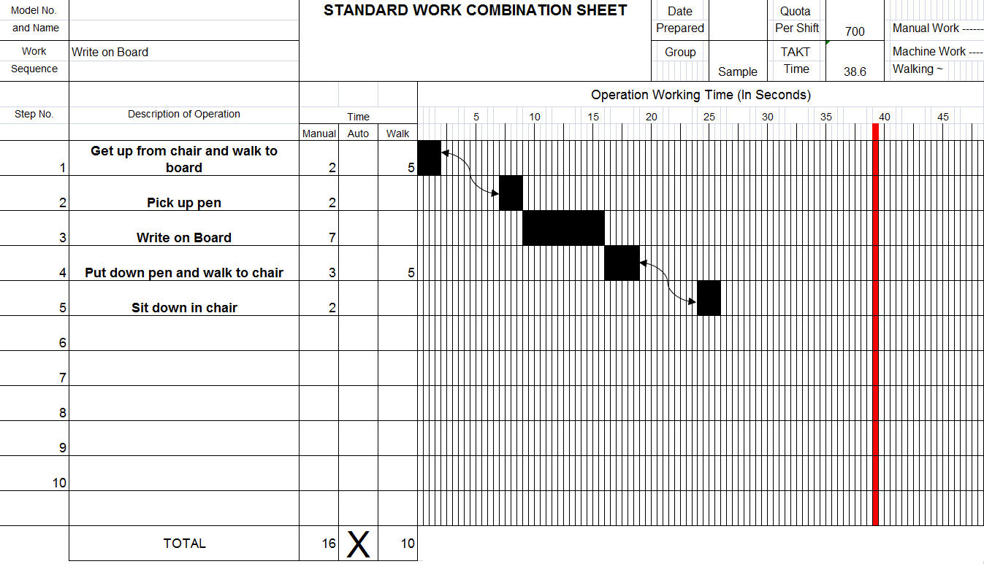
Standard Work Combination Sheet
Standard Work Documentation
Wait Time
13 Seconds
Notes:
SAY: “The Standard Work Combination Sheet looks like this. The first operation is to pick the raw material (2 seconds of manual time), then, operation #2 is to unload and start the mill. In this step, there are 4 seconds of manual time, 65 seconds of automatic time and three seconds of walk time to get to the third station. TAKT time is shown on the work combination sheet is shown in red. In this case the Associate can complete all tasks in 70 seconds, the TAKT time is 77 seconds. In this case, the Associate can complete all tasks in less than the TAKT time.”

Slide 46
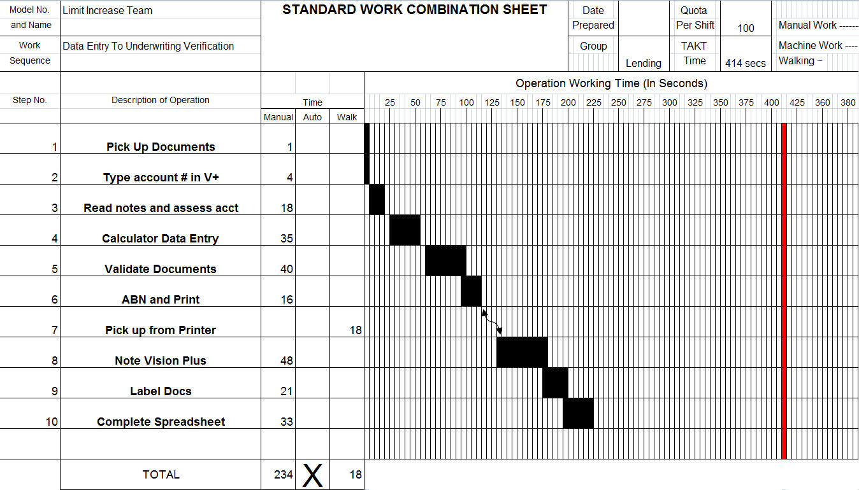
Standard Work Combination Sheet Tips
Standard Work Documentation
Wait Time
180 Seconds
Notes:
SAY: “Here are some tips for Standard Work Combination sheets. Use one sheet per Associate and post the sheet at the Associate’s work station. Create playbooks for the various TAKT times at which you plan to operate. Always date your document. Work Combination Sheets do not replace more detailed work instructions. As is the case with many of the Lean tools, use the combination sheets to highlight kaizen opportunities.”

Slide 47
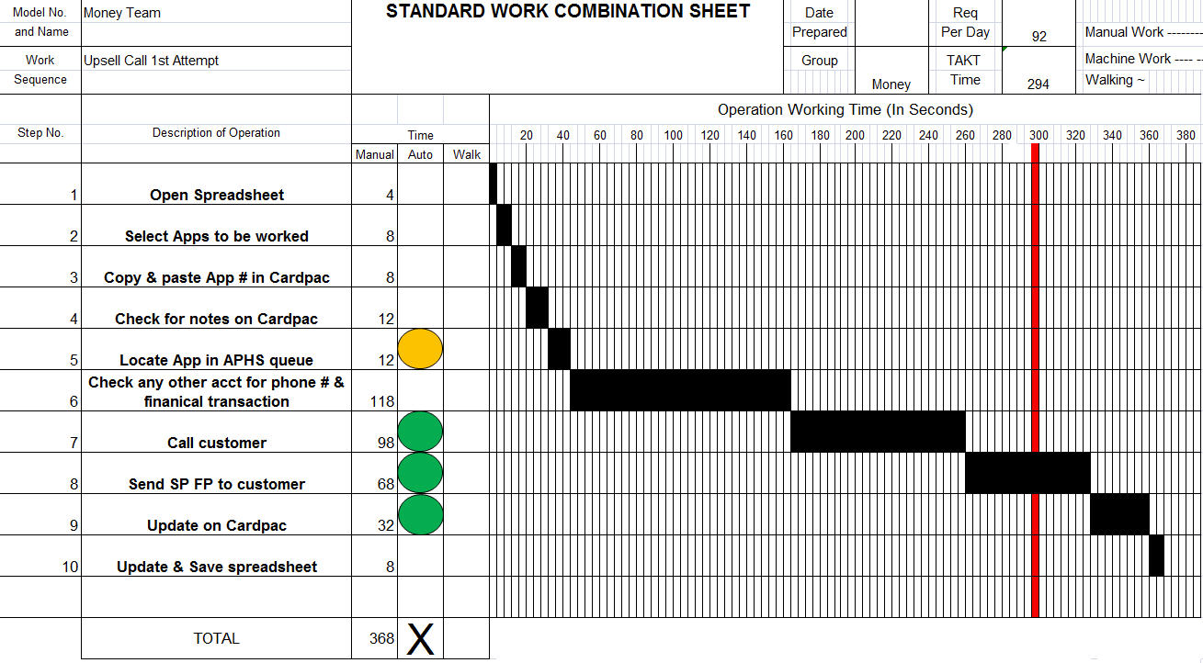
Standard Work Combination Sheet, Up-sell call 1st Attempt
Standard Work Documentation
Need To Improve Process
Processing Time=368 Sec
Takt Time =- 294 Sec
PT reduction- Fax from Desk top
WS- Call Logic
WS- System & Doc notations
PT Reduction- One Screen to Access APHP queues
Reduce Processing time by 25%
Notes:
SAY: “Similarly, in this case the current process exceeds the takt time by 74 seconds. In order for the process to meet customer demand the processing time needs to be reduced by 25%”

Slide 48
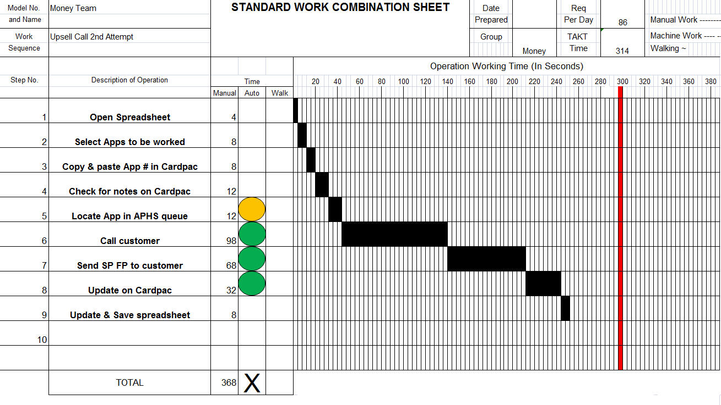
Standard Work Combination Sheet, Up-sell call 2nd attempt
Standard Work Documentation
Processing Time = 250 Sec
Takt Time 314 Sec
Wait Time/ Capacity
PT reduction- Fax from Desk top
WS- Call Logic
WS- System & Doc notations
PT Reduction- One Screen to Access APHP queues
Reduce Processing time by 35%
…Capacity for Growth
Notes:
SAY: In this case the opposite is true. Here the Associate has a 64 second wait on each call. A logical thing to do is to see if it is possible t shift work from the first call to the second call Associate to allow the overall operation to support the customers demand.”

Slide 49
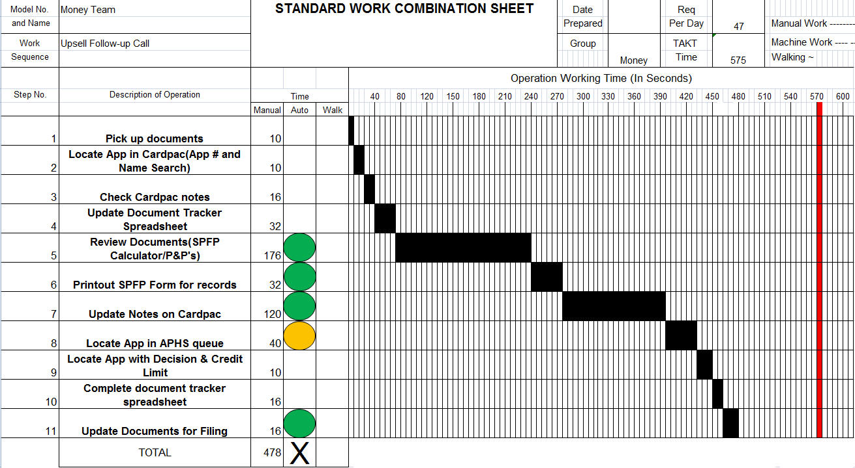
Standard Work Combination Sheet, Up-sell call 2nd attempt
Standard Work Documentation
Processing Time = 478 Sec
Takt Time = 575 Sec
PT reduction- Automated xls
Checklist for decision making
PT reduction- Eliminate Cal print-out
WS- System & Doc notations
Wait Time/ Capacity
Reduce Processing time by 35%
…Capacity for Growth
PT Reduction- One Screen to Access APHP queues
Notes:
SAY: “Here we see the same thing as the previous sheet.”

Slide 50
Standard Work Combination Tips
Standard Work Documentation
One sheet per Associate
Post at the Associate’s workstation
Create “playbook” with various TAKT Times
Always date your documentation
Combination Sheets do not replace more detailed work instructions
Use Combo Sheets to highlight kaizen opportunities
Always draw TAKT Time in red
Notes:
SAY: “Here are some tips for Standard Work Combination sheets. Use one sheet per Associate and post the sheet at the Associate’s work station. Create playbooks for the various TAKT times at which you plan to operate. Always date your document. Work Combination Sheets do not replace more detailed work instructions. As is the case with many of the Lean tools, use the combination sheets to highlight kaizen opportunities.”

Slide 51
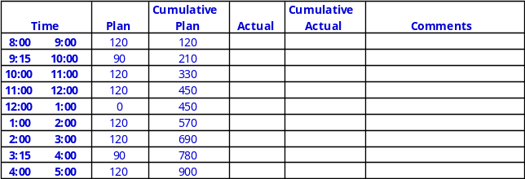

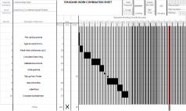
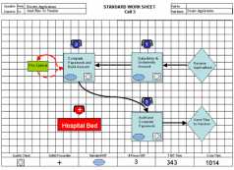
Standard Work Playbook
Standard Work Documentation
Each Demand level has a “Play”
For each Play:
  Associate Loading Chart
  Standard Work Combination Sheets
  Standard Work Sheets
  Daily Output Goals
Notes:
SAY: “For each demand level, represented by the different TAKT times, the Standard Work Sheets represent a ‘play.’ For each play, there are sets of Associate Loading Charts, Standard Work Combination Sheets, Standard Work Sheets and daily output goals.”

Slide 52
Playbook
Standard Work Documentation
Associate Play Book Matrix (For all incoming paper based applications)
Maximum Applications | Minimum Applications | Associates
1,200 | 1,001 | 14
1,000 | 801 | 12
800 | 601 | 10
600 | 401 | 7
400 | 201 | 5
200 | 101 | 3
100 | 51 | 2
50 | 1 | 1
Notes:
SAY: “Here is an example of a portion of a playbook that details how the number of Associates change when demand changes.”

Slide 53
Standard Work Sheet
Standard Work Documentation
Details the work sequence of Associate visually
Shows the Associate’s work sequence in respect to the physical work area
Highlights Standard WIP requirements, inspect, and safety precautions
Useful in visually detailing Associate assignments
Also used as an audit tool for supervisors
Helpful when new Associates are assigned to the work area
Notes:
SAY: “The Standard Work Sheet visually details the work sequence of an Associate and shows the Associate’s work sequence with respect to the physical work area. The Standard Work Sheet shows the Standard WIP requirements, gauge and safety conditions. These are useful in visually detailing Associate assignments and are an audit tool that should be used by supervisors. The Standard Work Sheet is also the tool to use to help train new Associates assigned to an area.”

Slide 54
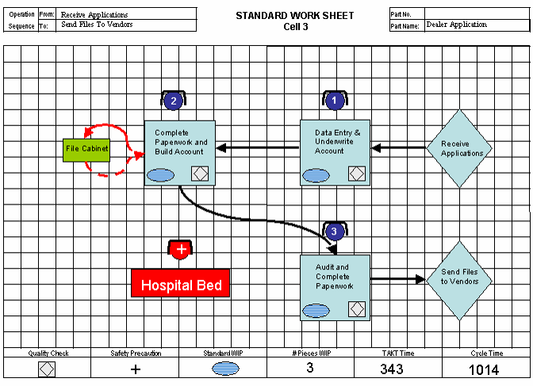
Standard Work Sheet
Standard Work Documentation
Notes:
SAY: “This chart highlights the Standard Work Sheet. Note the identification of the SWIP, key safety locations and sequence of the associate.”

Slide 55
Associate Loading Chart
Standard Work Documentation
Details the process time for Associates
Compares Associate process times to TAKT time
Allows supervisor to understand manning requirements at a glance
Facilitates the kaizen opportunities that may exist
Incorporates “Least Associate” concept
Notes:
SAY: “The next Standard Work document is the Associate Loading Chart. In this chart the process time for all Associates is detailed. It compares the Associate process times to TAKT time. It allows the supervisor to understand manning requirements at a glance. The Associate Loading Chart facilitates kaizen opportunities that may exist and incorporates the least Associate concept.”

Slide 56
Associate Loading Chart
Standard Work Documentation
TAKT Time
A
B
C
D
E
Natural
TAKT Time
A
B
C
D
E
Traditional
TAKT Time
"Least Associate"
A
B
C
D
E
Front Loaded
Notes:
SAY: “This page should help understand Operator Loading Charts. The first graph shows the operator loads and the TAKT time. Note how operations A and C exceed TAKT time. Operator A & C are items that should be addressed in kaizen activities. In the second chart, we show the traditional picture of the Operator Loading Chart as compared to TAKT time. In this case, each operator is equally loaded and is less than the TAKT time. In the least operator method the operators are loaded to TAKT time and the amount of work remaining is given to the least operator.
We always want to make opportunities for improvement visual – “Make it visual, make it ugly”. When we use the one called “front loaded” a casual observer can stop at the cell, watch for one process and see that 4 people are working all the time and one is working half the time. This prompts the observer to ask – can we eliminate some NVA work to eliminate the 5th position? – or – can we move appropriate work from another cell into this cell to load that 5th person up more efficiently. In the “traditional” method all the casual observer can see is everyone is busy but can’t see that they are cycling faster than necessary and therefore has too many people.
We put the partly loaded person at the end rather than the beginning since they could go faster and thus overproduce (waste) thus building inventory (waste) in front of the next person.”

Slide 57
Takt/Process Time Graph
Standard Work Documentation
Takt Time : 14:22
= 1.6 shifts
Current Resources = 6
Process Time
1
2
3
4
5
6
Associates
Notes:
SAY: “Here again is an example from one of our businesses. By applying standard work we were able to determine that only 1.6 ~ really 2 people were needed to support the current demand.”
SAY: “When comparing this to the actual staffing we see that there are 6 people doing the job on a full time basis. This should raise the question in managements mind as to what else are they doing that we may not have captured and how do we separate this other work so that I can have just 2 people performing this task?”

Slide 58
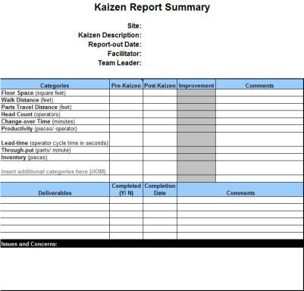
Kaizen Results
Standard Work Documentation
Notes:
SAY: “Here is a form we recommend you use to track the kaizen results. This makes it easier to have a visual of the improvements made to date and the opportunities that still exist.”
NOTE: This form is in excel and additional measurements could be added per the event objectives.

Slide 59
Prepare for Final Report-Out to Management
Standard Work Documentation
All team members should contribute to the final report-out presentation to management
Report-out should include
  Introduction of Team
  Review of Event Charter
  Review of Former Process and Documentation Forms
  Review of Improvement Opportunities Identified and Implemented
  Review of Standard Work Documentation and Kaizen Results Form
  Review of Kaizen Newspaper
Typical Report-Out times are 15 minutes for presentation and 15 minutes for questions
Notes:
DO: Cover report-out guidelines.

Slide 60
Review Exercise
2 Minute Review
In pairs, or in small groups, spend 2 minutes discussing key learning's and take-aways from this Standard Work Event thus far
One person from each group will share one learning that was discussed with the rest of the class

Slide 61
Standard Work Summary
Quality products produced at TAKT time
Productive utilization of people
  Associates should operate
  High associate productivity through loading to TAKT time
  Designed for minimum and maximum manning
Continuous flow, and flow of Associates
  Workstation optimized for presentation of work; design supports continuous associate movement but minimizes wasted motion
Immediate flow information/feedback
Expose problems
Notes:
SAY: “In reviewing flow concepts, note how there are quality products produced at TAKT time. Flow supports improved utilization of people through higher productivity and proper staffing by design. It also enables the continuous flow of work and associates and provides immediate feedback, flow information, and exposes problems to the organization.”

Slide 62
Standard Work Summary
If a process is not documented, there is no process
Consistency in operations = improved quality
Without a standard, there can be no consistent improvement
Standard Work is dynamic, not stagnant
Standard Work is a management tool
Do not use Standard Work to lay off Associates
If Standard Work is >30 days old, ask questions
  Has demand changed?
  Have improvements been made?
Notes:
SAY: “In closing, if a process is not documented, there is no process. The more consistent the operations, the better the quality. Without a standard, there can be no improvement. Standard Work is a dynamic tool used by management and should not be used to “justify” laying off associates. Standard Work should be no older than 30 days.”

Slide 63
Standard Work Summary
“If you don’t understand Standard Work, you don’t understand the Toyota Production System.”
Senji Niwa (1989) Shingijutsu Co., Ltd.
Notes:
SAY: “This is a strong statement.”
SAY: The founders of Shingijutsu Consultants have direct ties/lineage to Taichi Ohno and the Toyota Production System. Mr. Niwa was one of the original partners. What do you think he meant by this statement?
SAY: “Standard Work is a foundational element of the Toyota Production System. A lack of understanding of these concepts translates into a poor understanding of the Toyota Production System.”

Slide 64
Other Modules In This Series:
5S
Standard Work
Total Productive Maintenance (TPM)
Administrative Lean
Cell Design/ Production Preparation Process (3P)
Kaizen
Kanban
Problem Solving
Poka Yoke Quality Systems
Transaction Process Improvement (TPI)
Cause & Effect Diagram with the Additions of Cards (CEDAC)
Single Minute Exchange of Dies (SMED)
Value Stream Mapping (VSMi®)
Visual Management
Managing Daily Process Excellence
For More Information Please Contact:
Mark DeLuzio, President and CEO
+1.860.234.0915
mark.deluzio@leanhorizons.com
Strategically Creating Value Through the Elimination of Waste

